Slide 1
FAIRfy 23andme
David Blackwell, Tufts Health Plan
Marina Yurieva, Jackson Laboratory
Daniel Dacey, UMass Lowell
Russell Kunes, Harvard

Slide 2
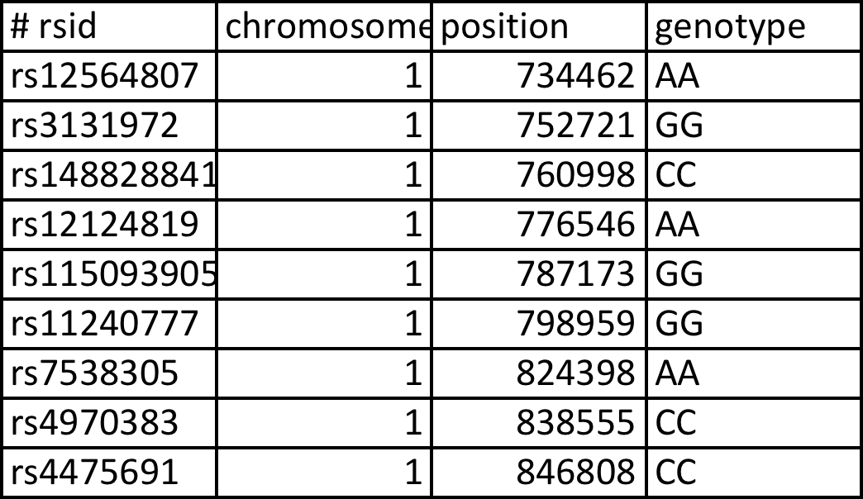
David’s variants
610564 variants

